Slide 1
IndoorGML SWG
Online Meeting
Sept. 7, 2022
Ki-Joune Li, Pusan National University

Slide 2
Meeting Agenda
Review on the last meeting
Implementation Updates
Discussion
Directed or undirected graph: issue #7
Different cardinalities between primal and dual spaces: issue #6
Mapping between CellBoundary and CellSpace: issue #5
Future Plan

Slide 3
Review on the last meeting
Review on the last meeting
Question on the PD issue: The case explained at the github (https://github.com/opengeospatial/IndoorGML-SWG/issues/3) by Abdou doesn't exactly reflect the indoor structure and may lead to confusions. Anyway, the decision is to keep PD but change the cardinality between CellSpaceBoundary and Edge (at the side of CellSpaceBoundary from 1..1 --> 0..1)
We need a guideline or manual in addition to the standard specification document as it is not very clear only with the standard document: such as use guide or implementation guide.

Slide 4
Review on the last meeting
Implementation of IndoorGML 2.0
Scott clarified that we need at least three implementations as the P&P explains.
Possible implementations: FME (e.g. IndoorGML 1.1 -> IndoorGML). ISPRS project (conversion from IFC to IndoorGML 2), and others such as Syrius. Dean will check the possibility of the implementation with FME and it looks not very difficult at this monent.
It may be useful to make a comparison table between 1.1 and 2.0

Slide 5
Review on the last meeting
Typographic Errors in IndoorGML 1.1 issued by Gobe
to include this agenda at the next meeting in Singapore and make a corrigendum

Slide 6
IndoorGML 2.0 Implementations
IndoorSIM From Syrius Robotics (Kunlin Yu)
Developing an edition tool for IndoorGML 2.0

Slide 7
IndoorGML 2.0 Implementations
Implementations such as
Using FME
ISPRS project (IFC->IndoorGML 2): Available through GitHub
+ pgRouting by Vicky

Slide 8
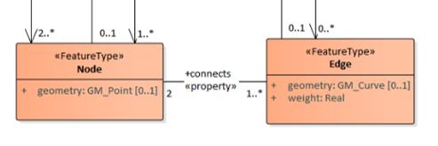
Discussion – Directed or Undirected Graph
https://github.com/opengeospatial/IndoorGML-SWG/issues
Surface has direction → Decision: Not include it (stay as it is. i.e. undirected)

Slide 9
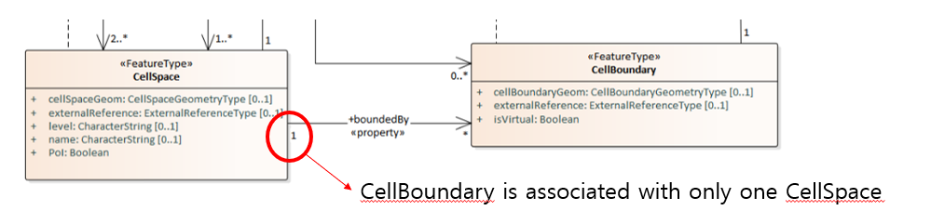
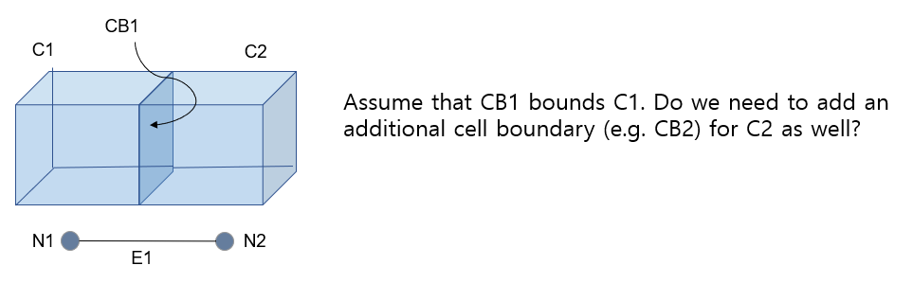
Discussion – Mapping between Cell Boundary and Cell Space
Conclusion: We have to make two CBs with reversed orientation: CB1 for C1 and CB2 for C2

Slide 10
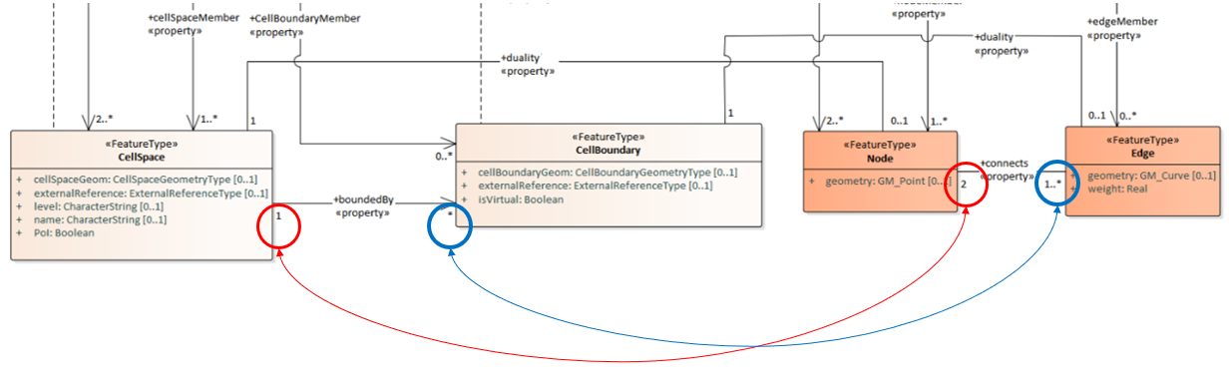
Discussion – Different Cardinalities
https://github.com/opengeospatial/IndoorGML-SWG/issues
Not all CB are used for Edge but All Edges are associated to CB
Same as case 1

Slide 11
Plan
Decisions:
At Singapore Meeting, submit the current draft to SWG for SWG voting
Proceed the implementation concurrently to upgrade it to “final” standard if possible.

